Slide 1
Злоупотребление властью и патологии лидерства
Алёшин Александр, Максим Сергеев
ИУ5-73Б

Slide 2

Влияние, власть и лидерство
Влияние
Влияние – это действие, тактика поведения одного индивида, которое приводит к изменениям в поведении другого индивида

Slide 3
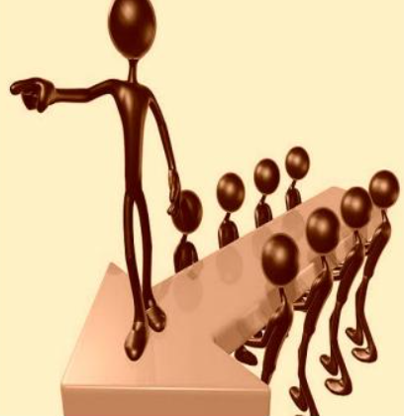
Влияние, власть и лидерство
Власть
Власть — это способность (возможность) влиять на поведение других людей с целью подчинить их своей воле.

Slide 4
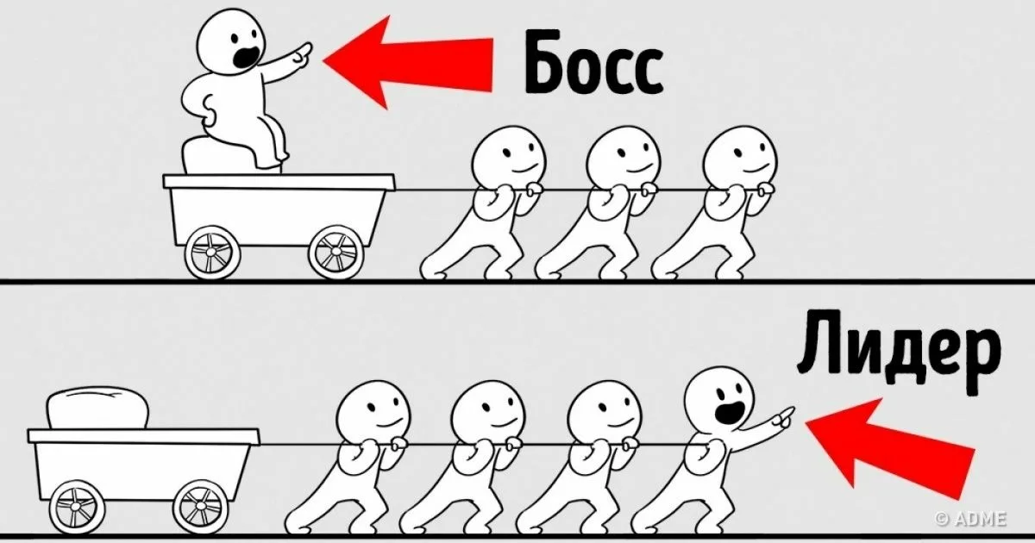
Влияние, власть и лидерство
Лидерство
Лидерство — это общественное влияние, которое объединяет других и мотивирует прикладывать максимальные усилия для достижения цели. За лидерами идут не из-за формальной власти и полномочий, а из-за доверия и уважения.

Slide 5
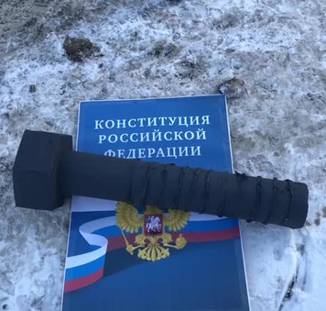
Влияние / власть?
В основе управленческой власти лежит влияние, регламентированное нормативно-правовыми документами, законодательством и наделяющего руководителя определенными полномочиями.

Slide 6
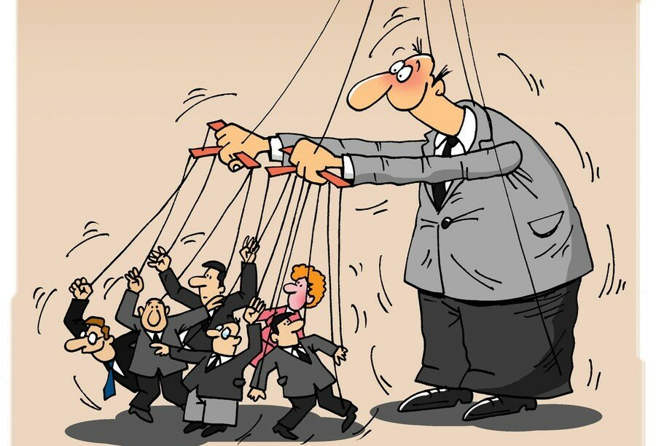
Виды власти
Законная власть
Экспертная власть
Основанная на принуждении
Основанная на вознаграждении
Информационная
Эталонная (референтная)

Slide 7
Transformational leadership infographics
Inspirational motivation
Intellectual stimulation
Saturn is a gas giant and has several rings
Neptune is the farthest planet from the Sun
Idealized influence
Individualised consideration
Jupiter is a gas giant and the biggest planet of them all
Four I’s
Ceres is located in the main asteroid belt
The Sun is the star at the center of the Solar System

Slide 8
Transformational leadership infographics
Idealized influence
Mercury is the closest planet to the Sun and the smallest one
Individualized consideration
Venus has a beautiful name and is the second planet from the Sun. It has a Greek name
Inspirational motivation
Earth is the third planet from the Sun and the only one that harbors life
Intellectual stimulation
Despite being red, Mars is actually a cold place. It’s full of iron oxide dust
Performance expectation
Jupiter is a gas giant and the biggest planet in the Solar System

Slide 9
Transformational leadership infographics
Mercury is the closest planet to the Sun and the smallest one
Venus has a beautiful name and is the second planet from the Sun
Earth is the third planet from the Sun and the only one that harbors life
Leading change
Motivation
Breach resistance
Flexible leadership style
Persuasion
Engagement
Influence
Despite being red, Mars is actually a cold place. It's full of iron oxide dust
Jupiter is a gas giant and the biggest planet in the Solar System
Saturn is a gas giant and has several rings. It's composed of hydrogen

Slide 10
Transformational leadership infographics
Individual & organization characteristics
Leader behaviors and look-up-to significant values
Follower & group impacts, positive and negative ones
Outcomes, either positive or negative
Write here the idea
Write here the idea
Write here the idea
Write here the idea
Write here the idea
Write here the idea
Write here the idea
Write here the idea
Write here the idea
Write here the idea
Write here the idea
Write here the idea
Write here the idea
Write here the idea
Write here the idea
Write here the idea
Write here the idea
Write here the idea
Write here the idea
Write here the idea

Slide 11
Transformational leadership infographics
Inspirational motivation
Idealized influence
Mercury is the closest planet to the Sun and the smallest one
Venus has a beautiful name and is the second planet from the Sun
Intellectual stimulation
Individual consideration
Earth is the third planet from the Sun and where we live on
Despite being red, Mars is actually a cold place

Slide 12
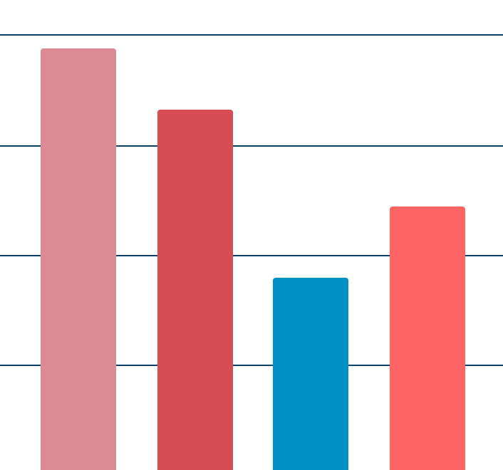
Transformational leadership infographics
100
Jupiter - 97%
Saturn - 83%
75
Jupiter is a gas giant and the biggest planet of them all
Saturn is a gas giant and has several rings
50
25
Neptune - 45%
Pluto - 61%
0
Neptune is the farthest planet from the Sun
Pluto is now considered a dwarf planet
Jupiter
Saturn
Neptune
Pluto
Follow the link in the graph to modify its data and then paste the new one here. For more info, click here

Slide 13
Transformational leadership infographics
Step 3: Earth
Earth is the third planet from the Sun and where we live on
Step 2: Venus
Step 4: Mars
Venus has a beautiful name and high temperatures
Despite being red, Mars is actually a cold place
Step 1: Mercury
Step 5: Jupiter
Mercury is the closest planet to the Sun and the smallest
Jupiter is a gas giant and the biggest planet

Slide 14
Transformational leadership infographics
Most important quote
“Neptune is the farthest planet from the Sun. It's also the fourth-largest object by diameter in the Solar System“
Key leadership characteristics
Change
Influence
Stimulation
Motivation
Engagement

Slide 15
Transformational leadership infographics
Jupiter
Pluto
Jupiter is a gas giant and the biggest planet of them all
Pluto is now considered a dwarf planet
Saturn
Ceres
Saturn is a gas giant and has several rings
Ceres is located in the main asteroid belt
Neptune
The Sun
Neptune is the farthest planet from the Sun
The Sun is the star at the center of the Solar System

Slide 16
Transformational leadership infographics
Leadership - 70%
Mercury is the closest planet to the Sun and the smallest
Entrepreneurship - 10%
Venus has a beautiful name and high temperatures
Consideration - 20%
Earth is the third planet from the Sun and where we live on

Slide 17
Transformational leadership infographics
Characteristic | Influence | Consideration | Motivation | Stimulation | Total
Mercury | 50% | 5% | 15% | 30% | 100
Venus | 46% | 13% | 7% | 34% | 100
Earth | 13% | 24% | 50% | 13% | 100
Mars | 5% | 5% | 10% | 80% | 100
Jupiter | 10% | 70% | 5% | 15% | 100
Saturn | 40% | 20% | 35% | 5% | 100
Neptune | 93% | 1% | 4% | 2% | 100

Slide 18
Transformational leadership infographics
Jupiter
Jupiter is a gas giant and the biggest planet in the Solar System
Saturn
Saturn is a gas giant and has several rings
Neptune
Neptune is the farthest planet from the Sun

Slide 19
Transformational leadership infographics
Characteristics
What people admire of her
Mercury is the closest planet to the Sun
Venus has a beautiful name, but it’s hot
Earth is the planet where we live on
Mars is actually a cold place, not hot
Jupiter is the biggest planet of them all
Venus has a beautiful name and is the second planet from the Sun. It’s terribly hot, even hotter than Mercury, and its atmosphere is extremely poisonous. It’s the second-brightest natural object in the night sky
Mission
Vision
Saturn is a gas giant and has several rings. It's composed mostly of hydrogen and helium
Neptune is the farthest planet from the Sun. It's also the fourth-largest object by diameter

Slide 20
Transformational leadership infographics
Idealized influence
Mercury is the smallest planet
Modeling the way
Inspiring with a vision
Saturn has several rings
Venus has a beautiful name
Challenging the process
Encouraging the heart
Jupiter is a gas giant
Earth is where we live on
Enabling others to act
Mars is actually a cold place

Slide 21
Transformational leadership infographics
Leader
Mercury
Venus
Earth
Followers
Mars
Jupiter
Saturn

Slide 22
Transformational leadership infographics
Leadership tasks |  | Success
Subordinate A | Subordinate B
Task 08
Task 11
Task 12
Task 04
Task 10
Task 02
Task 06
Task 09
Task 14
Task 03
Task 05
Task 01
Task 07
Task 13

Slide 23
Transformational leadership infographics
Step #1
Step #2
Step #3
Step #4
Mercury is the closest planet to the Sun
Venus has a nice name and high temperatures
Earth is the third planet from the Sun
Despite being red, Mars is actually a cold place

Slide 24
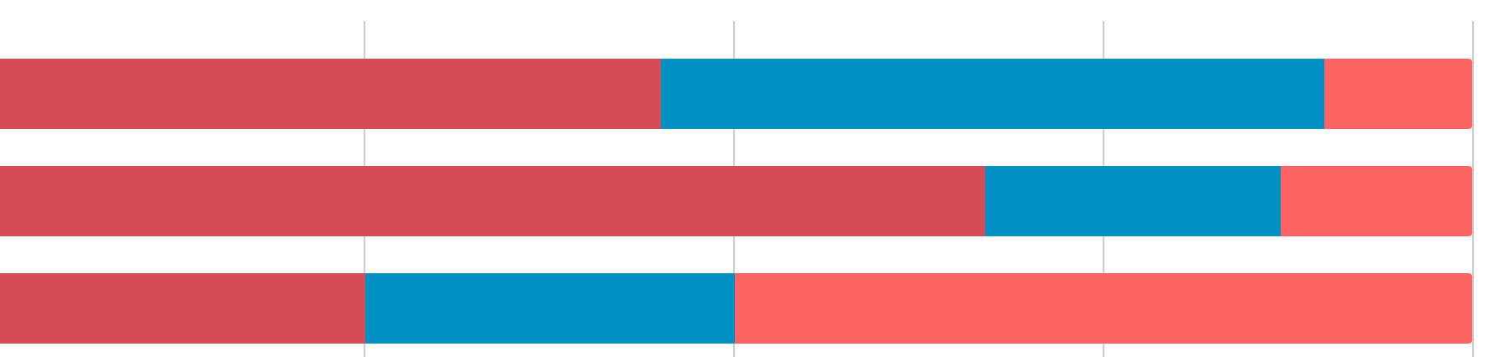
Transformational leadership infographics
Jupiter
Saturn
Neptune
0
25
50
75
100
The Sun
Ceres
Saturn
The Sun is the star at the center of the Solar System
Ceres is located in the main asteroid belt
Saturn is a gas giant and has several rings
Follow the link in the graph to modify its data and then paste the new one here. For more info, click here

Slide 25
Transformational leadership infographics
Mercury
Mercury is the closest planet to the Sun and the smallest
Resourceful
Leadership
Attitude
Venus
Venus has a beautiful name and high temperatures
Teamwork
Strategic
Learner
Earth
Earth is the third planet from the Sun and where we live on
Resilience
Caring
Thinker

Slide 26
Transformational leadership infographics
Intellectual stimulation
Individual thought
You can write your observations in here
You can write your observations in here
You can write your observations in here
You can write your observations in here
You can write your observations in here
You can write your observations in here
You can write your observations in here
You can write your observations in here
You can write your observations in here
You can write your observations in here

Slide 27
Transformational leadership infographics
 | Value A | Value B | Value C | Value D | Value E
Person A | Yes | Yes | No | In progress | Yes
Person B | In progress | No | Yes | No | In progress
Person C | No | Yes | Yes | Yes | In progress
Person D | Yes | Yes | No | No | Yes
Person E | No | No | Yes | Yes | In progress

Slide 28
Transformational leadership infographics
Component A
Component B
Component C
Component D
Despite being red, Mars is actually a cold place
Jupiter is a gas giant and the biggest planet
Saturn is a gas giant and has several rings
Neptune is the farthest planet from the Sun

Slide 29
Transformational leadership infographics
Step #1
Step #2
Mercury is the closest planet to the Sun and the smallest
Venus has a beautiful name and high temperatures
Step #5
Step #3
Jupiter is a gas giant and the biggest planet
Earth is the third planet from the Sun and where we live on
Step #4
Despite being red, Mars is actually a cold place

Slide 30
Transformational leadership infographics
Intellectual stimulation
Better decision-making
Saturn is a gas giant and has several rings
Jupiter is the biggest planet of them all
Consequences of transformational leadership
Individualized consideration
Individual leadership
Neptune is the farthest planet from the Sun
Ceres is located in the main asteroid belt

Slide 31
Transformational leadership infographics
Component A
Component D
Jupiter is the biggest planet of them all
Despite being red, Mars is actually a cold place
Component B
Component E
Earth is the beautiful planet we all live on
Neptune is the farthest planet from the Sun
Component C
Component F
Venus has a beautiful name, but it’s hot
Saturn is a gas giant and has several rings

Slide 32
Transformational leadership infographics
Model - 30%
High values - 25%
Great spirit - 45%
Mercury is the closest planet to the Sun and the smallest
Venus has a beautiful name and is the second planet from the Sun
Earth is the third planet from the Sun and the only one with life

Slide 33
Transformational leadership infographics
 | Transformational leadership around the world
 | North America | Europe | Asia
Intellectual stimulation | Write your info here | Write your info here | Write your info here
Individualized consideration | Write your info here | Write your info here | Write your info here
Inspirational motivation | Write your info here | Write your info here | Write your info here
Idealizing & influencing | Write your info here | Write your info here | Write your info here

Slide 34
Transformational leadership infographics
Jupiter
Saturn
Jupiter is a gas giant and the biggest planet
Saturn is a gas giant and has several rings
Pluto
Neptune
Pluto is now considered a dwarf planet
Neptune is the farthest planet from the Sun

Slide 35
Transformational leadership infographics
Most important transformational values
Vision to future
Empowerment
Change agent
Mercury is the closest planet to the Sun
Earth is the third planet from the Sun and where we live on
Venus has a beautiful name and high temperatures

Slide 36
Instructions for use
In order to use this template, you must credit Slidesgo in your final presentation.
You are allowed to:
- Modify this template.
- Use it for both personal and commercial projects.
You are not allowed to:
- Sublicense, sell or rent any of Slidesgo Content (or a modified version of Slidesgo Content).
- Distribute Slidesgo Content unless it has been expressly authorized by Slidesgo.
- Include Slidesgo Content in an online or offline database or file.
- Offer Slidesgo templates (or modified versions of Slidesgo templates) for download.
- Acquire the copyright of Slidesgo Content.
For more information about editing slides, please read our FAQs or visit Slidesgo School:
https://slidesgo.com/faqs and https://slidesgo.com/slidesgo-school

Slide 37
Instructions for use (premium users)
As a Premium user, you can use this template without attributing Slidesgo or keeping the "Thanks" slide.
You are allowed to:
Modify this template.
Use it for both personal and commercial purposes.
Hide or delete the “Thanks” slide and the mention to Slidesgo in the credits.
Share this template in an editable format with people who are not part of your team.
You are not allowed to:
Sublicense, sell or rent this Slidesgo Template (or a modified version of this Slidesgo Template).
Distribute this Slidesgo Template (or a modified version of this Slidesgo Template) or include it in a database or in any other product or service that offers downloadable images, icons or presentations that may be subject to distribution or resale.
Use any of the elements that are part of this Slidesgo Template in an isolated and separated way from this Template.
Register any of the elements that are part of this template as a trademark or logo, or register it as a work in an intellectual property registry or similar.
For more information about editing slides, please read our FAQs or visit Slidesgo School:
https://slidesgo.com/faqs and https://slidesgo.com/slidesgo-school

Slide 38
Infographics
You can add and edit some infographics to your presentation to present your data in a visual way.
Choose your favourite infographic and insert it in your presentation using Ctrl C + Ctrl V or Cmd C + Cmd V in Mac.
Select one of the parts and ungroup it by right-clicking and choosing “Ungroup”.
Change the color by clicking on the paint bucket.
Then resize the element by clicking and dragging one of the square-shaped points of its bounding box (the cursor should look like a double-headed arrow). Remember to hold Shift while dragging to keep the proportions.
Group the elements again by selecting them, right-clicking and choosing “Group”.
Repeat the steps above with the other parts and when you’re done editing, copy the end result and paste it into your presentation.
Remember to choose the “Keep source formatting” option so that it keeps the design. For more info, please visit Slidesgo School.

